Slide 1

Buying Intent
demo Report
Analysis by

Slide 2

Contents
Understanding TRA and Buying Intent®
Brand’s Consumers’ Profile
Industry Analysis
Brand Trust Analysis
How Brands Resonate With Audiences
Emergent Brand Personalities
Respondent Preferences By Demographics
Findings & Recommendations

Slide 3

1. Understanding tra and
Buying Intent®

Slide 4
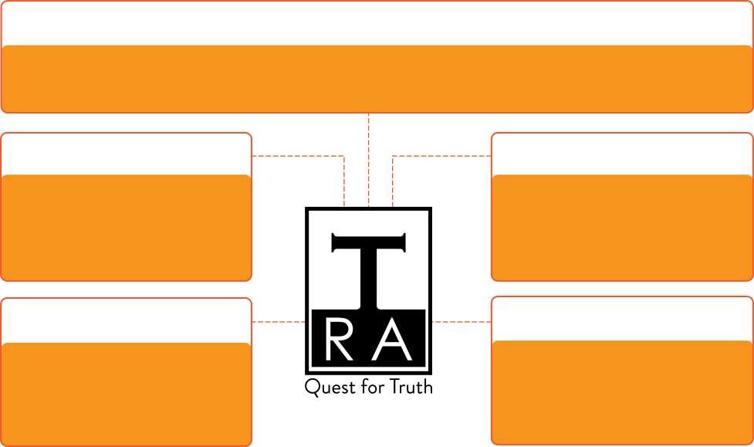


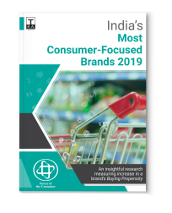
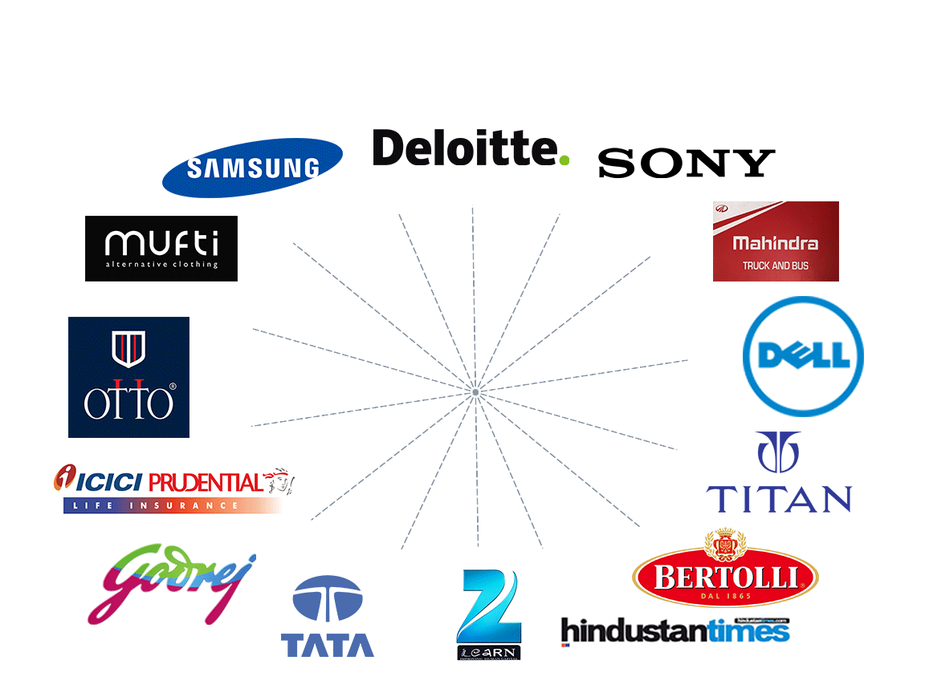
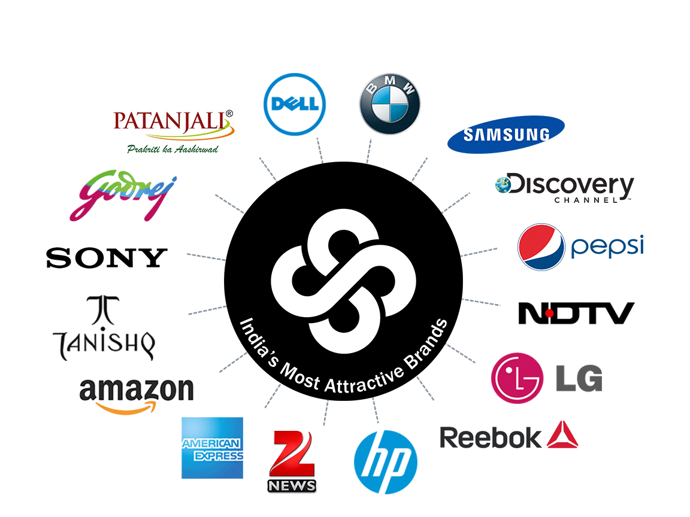

TRA Research’s Background
TRA’s Snapshot
Providing researched insights on Buying Intent
Research Methodology Partner
Publishing syndicated research
Indian Statistical Institute
13 YEARS
13th
Edition
Data-points
25 MILLION
Established
Global Copyrights
Buying Intent data on
2010
3
15,000 BRANDS
8th
Edition
Consumer-influencers (Annually)
6,000
Brands Measured on
Clients
Fieldwork (Annually)
97 Intangible
Attributes
200+
Brands
32,000 HOURS
2nd
Edition
Primary research
IN 16 CITIES
Some of our Clients
Buying Intent data clients
Licensing – As a stamp of surety
Buying
Propensity
Data

Slide 5
TRA's Proprietary Buying Intent Model®
TRA's Buying Intent Model has been created after research with over 300 Psychologists, Sociologists, Anthropologists, and Communication experts
TRA's Buying Intent Model is designed to understand stakeholder needs and Trusts, the combination of which leads to buying behaviour
TRA evolved Buying Intent after analyzing that the age of 'selling' is dead - a brand can only help a customer buy
TRA's model analyses the intangibles that lead to stakeholder buying decisions
5

Slide 6
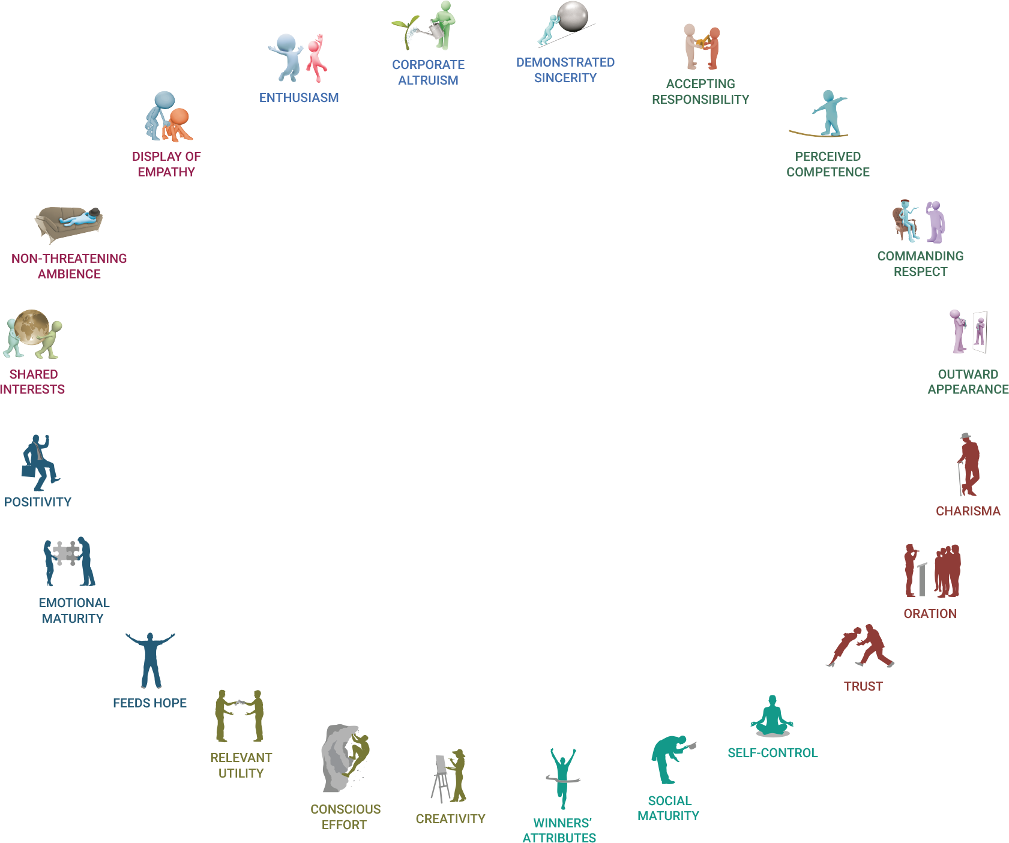

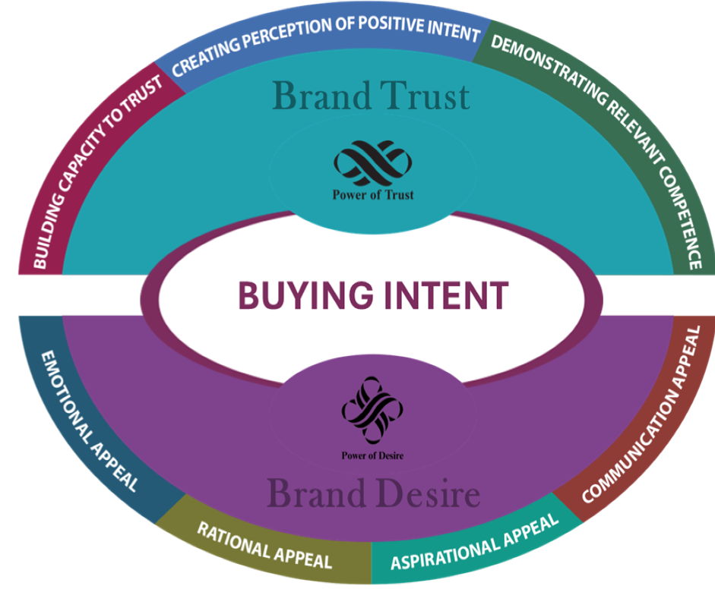

TRA's Proprietary Buying Intent Model®
Guides brand to achieve buying fulfillment for the customer
Is made of Trust and Trust - the combination of which leads to a magnetic, subliminal pull
Creates a standardized basis for all buying behavior
Adopted by over 200+ brands as key brand metric
Helps a brand remove paradigm blinkers and look at the brand anew
6

Slide 7






Process & Methodology of TRA’s Brand Trust Report
Brand Trust Matrix
  TRA measures Trust through its proprietary 10 Behaviours Brand Trust Matrix
  After conducting several interviews with Sociologists, Psychologists & Communication Experts — and intense research over a period of 5 years
Methodology for data collection
Consumer influencers interviewed with the help of a questionnaire that was designed to ensure to get valuable answers to the 425 questions
Stringent minimum acceptance criteria were maintained to ensure authenticity of data
Questionnaire Design
The questionnaire has been designed to ensure that the respondent is able to freely bring brand associations without any bias or channelization
Multiple Levels of Scrutiny
Examination of interviewers, process quality, 100% back-checks, stringent quotas to avoid brand bias are a part of multiple levels of scrutiny to achieve maximum data accuracy
  The four statistical parameters
  Standard deviation of suitability
  Position average
  Suitability average score of the brand &
  Number of occurrences
7

Slide 8
16 cities of TRA’s Brand Trust Report fieldwork
NORTH | EAST | WEST | SOUTH
Delhi | Kolkata | Mumbai | Chennai
Chandigarh | Guwahati | Ahmedabad | Bangalore
Lucknow |  | Pune | Hyderabad
Jaipur |  | Nagpur | Cochin
 |  | Indore | Coimbatore

Slide 9
2. Brand’s CONSUMERS’ PREFERENCES
(By language and media preferences)

Slide 10



English proficiency of the consumers
(basis Trust expressed)
“English ‘Speak, Read & Write’ of Brand A, Brand B, and Brand C are very similar with only 1.23% difference
While on the surface the audience which shows trust towards the two Southern brands may seem similar to Brand B, when regional language proficiency is considered, they can be seen to be distinctly different
Overall average
Please note that respondent had to score minimum of 3/5 in English & one and one more language
10

Slide 11


Language proficiency of consumers (basis Trust expressed)
“Brand A & Brand C have a very similar language proficient consumers”
Brand A has 82% Southern language dominance, and Brand C has 92%.
Marathi is also a common language between the two
South Indian proficient consumers are as under:
  Brand A – 83% (Tamil – 33%, Malayalam – 30% Telugu – 19%)
  Brand C – 92% (Tamil – 51%, Malayalam – 33% Telugu – 8%)
Brand B shows only 13% Southern language dominance and 38% for Marathi. Bengali and Hindi are 27% and 20% respectively
11

Slide 12


Media which consumers find most effective (Effective = Most consumed + Most informative)
“Times of India, Eenadu and The Hindu are the common media preferred by both Brand A and Brand C ”
NDTV and Indian Express are 4th & 5th preferences by Brand C consumers, whereas Sakshi and Aaj Tak are Brand A consumer 4th & 5th preferences
Media Effectiveness Index
12

Slide 13

Media (Language) which consumers find most effective
“Brand A & Brand C show highest dominance in English as well as Telugu media”
In South, Brand A and Brand C consumers show similar preferences for Telugu and Tamil media
There is a higher preference for Malayalam media by Brand C (7%) consumers than Brand A consumers (3%)
48% Brand A consumers prefer regional media, for Brand C it is 43% (non-Hindi)
Brand A has 10% Hindi consumers
Media Effectiveness Index

Slide 14
Media which consumers find most effective – Print, TV & Online
“Similarity of Brand A & Brand C consumers is further reinforced by similarity of Print & TV choices”
66% Brand C & 37% Brand B consumers find Print as effective mode of media
Media Effectiveness Index
14

Slide 15
3. INDUSTRY ANALYSIS

Slide 16


Brand Trust Comparison of Overall category: 2022 vs 2021
63%
“Overall Category Trust Quotient of the category rose by 29% in 2022 over the previous report”
Significant brands which exited the top 1000 list in BTR 2023 were Brand F, Brand G, Brand H and Brand I
Among top 1000, Brand E dropped -90%% BDI, Brand A increased BDI by +63% while Brand B’s raised by massive +708%
Brand C and Brand D entered new to 2022 list
Brand Trust Index (BDI)
708%
90%
# All India Rank BTR 2023 / 2022
e.g. Brand A
Dark colour shade : Brand Trust Index 2022
Light colour shade : Brand Trust Index 2021
16

Slide 17

Conscious and Sub-conscious Trust (2022)
Brand A, Brand B & Brand C
Brand A
“The difference between Brand A and Brand C consumers is the way they interact with the brand”
Brand A consumers have a greater subliminal pull to the brand, but the brand less successful in engaging newer audiences (as it was also with Trust)
Brand C has a healthy mixture of both Conscious and Sub-Conscious Trust.
e.g. Brand A
Dark colour shade : Sub-conscious
(Decider)
Light colour shade : Conscious
(Learner)
Brand B
Brand C
Ideal Ratio: 50%:50%
17

Slide 18
4. Brand Trust ANALYSIS
(Compared with Brand A, Brand B and Brand C)

Slide 19
Brand Trust and Usage Comparison
# 219
Brand Usage
Brand Trust Index (BDI)
0.09 X
# 448
# 887
0.28 X
# All India Rank BTR 2023
Brand C Brand Trust Quotient is 72% higher than Brand A, and its’ Brand usage is higher by 80% from Brand A
Brand B’s Brand usage is higher by 0.06 times & 94% over that of Brand A
Brand Trust > Usage shows there is good opportunity to convert Trust into improved usage
19

Slide 20

Brand Trust Comparison : 2021 vs 2022
Brand A, Brand B & Brand C
#127
Brand Trust Index (BDI)
0.16 times
“Brand A & Brand C both fell in Trust scores, while Brand B rose over the last report”
#219
84%
#212
1.63 times
63%
0.1 times
90%
#274
#448
#887
# All India Rank BTR 2023
20

Slide 21

Brand Trust Trends: 2018 - 2022
Brand A, Brand B & Brand C (with Brand Trust Indices)
“After leading the category in Trust in 2018 and 2020 reports, Brand A fell to 2nd in 2021 and 3rd in 2022 among compared set”
  Brand A rank fall in 2020 = -94 places
  Brand A rank fall in 2021 = -675 places
#127
Brand Trust Index (BDI)
#120
#142
#163
#212
#219
+6% CAGR
#215
#274
#448
#486
#737
+9% CAGR
#887
-46% CAGR
BTR 2018
BTR 2020
BTR 2022
BTR 2023
21

Slide 22
5. BRAND Personality that
resonates with audiences
Understanding anthropomorphic relationships

Slide 23
Brand Trust Archetype – Brand Trust
“Brand A has the highest Creating Perception of Positive Intent while that for Brand C is the lowest of all other brands”
Brand A should differentiate their key messages as consumers get similar overarching messages from the competing brands
These three Archetypes of Trust comprise of 10 composites classified for easy application in business scenarios
Brand Trust Index (BTI)
23

Slide 24
6. Brand’s emergent Personality

Slide 25
Brand A vs Brand B vs Brand C Behaviours
that resonate with consumers
Brand Trust Index (DI)
“Brand A prominent key messages are Creativity, Feeds Hope, Relevant Utility, Trust & Self control which are above the average level ”
It is suggested that Brand A should focus its’ communication in around Rational Appeal and Brand Behaviours of ‘Creativity’ and ‘Relevant Utility’ to retain these behavioural advantages
25

Slide 26
7. RESPONDENT PREFERENCES
BY DEMOGRAPHICS

Slide 27

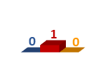
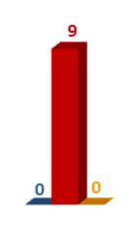
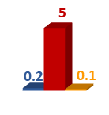
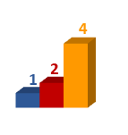
Zonal Analysis of Brand Trust
Brand A, Brand B & Brand C
North BDI
East BDI
West BDI
Brand A = 0.04 X Brand B
Brand A = 1.6X Brand C
Brand A
Brand B
Brand C
South BDI
Brand A = 0.6 X Brand B
Brand A = 0.2 X Brand C
Color Legend
Brand A leads Brand B/Brand C in Consumer Buying Keenness
Brand B/Brand C leads Brand A in Consumer Buying Keenness
Scores = BDI x 100
27

Slide 28



Zonal Analysis of Brand Trust
Brand A 2021 vs 2022
“Brand A still gets maximum 83% Trust Quotient in Southern Zone in 2022”
In MBD 2022, Brand A Trust index has fallen by
96% in West
74% in South
Brand Trust Index (BDI)
96%
74%
100%
100%
28

Slide 29



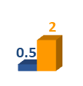






City-wise Analysis of Brand Trust
Brand A & Brand C
Chandigarh
Delhi
Lucknow
Jaipur
Guwahati
Indore
Ahmedabad
Kolkata
Nagpur
Brand A = 1.2 X Brand C
Mumbai
Brand A = 1.7 X Brand C
Pune
Hyderabad
Brand A = 0.2 X Brand C
Bangalore
Chennai Brand A = 0.2 X Brand C
Brand A
Brand C
Color Legend
Brand A leads Brand C in Consumer Buying Keenness
Brand C leads Brand A in Consumer Buying Keenness
Coimbatore Brand A = 0.2 X Brand C
Kochi Brand A = 0.3 X Brand C
Scores = BDI x 100
29

Slide 30
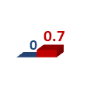
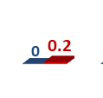
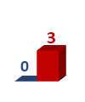
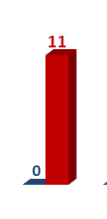

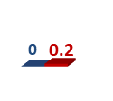

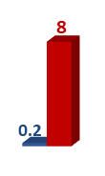


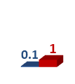



City-wise Analysis of Brand Trust
Brand A & Brand B
Chandigarh
Delhi
Lucknow
Jaipur
Guwahati
Indore
Ahmedabad
Kolkata
Nagpur Brand A = 0.6 X Brand B
Mumbai
Brand A = 0.03 X Brand B
Pune
Hyderabad
Brand A = 0.4 X Brand B
Bangalore
Brand A = 0.1 X Brand B
Chennai
Brand A
Brand B
Color Legend
Brand A leads Brand B in Consumer Buying Keenness
Brand B leads Brand A in Consumer Buying Keenness
Coimbatore
Brand A = 0.7 X Brand B
Kochi Brand A = 2.1 X Brand B
Scores = BDI x 100
30

Slide 31
City-wise Analysis of Brand Trust
Brand A
“Comibatore and Cochin show highest Trust for Brand A”
Brand A seems to have a smaller city preference, even among the South cities
Nagpur scores 6% Brand Trust Quotient for Brand A
31

Slide 32
City-Wise Analysis of Brand Trust
Brand A 2021 vs 2022
Brand Trust Index (BDI) * 100
Scores = BDI x 100
32

Slide 33
Current age wise preference of consumers
Comparison 2022: Brand A, Brand B & Brand C
Brand Trust Index (BDI)
“Brand A’s audiences are largely between 31y to 40y”
Brand C’s audiences remain constant over last year for 46y to 50y
33

Slide 34
Current age wise preference of consumers
Comparison 2022: Brand A & Brand C
Brand Trust Index (BDI)
“Brand A’s audiences are largely between 31y to 40y”
Brand C’s audiences is maximum from the 31-35y cohort
34

Slide 35
Current age wise preference of consumers
Comparison 2022: Brand A, Brand B & Brand C
“59% of Brand A Trust is observed by consumers in 31-40 years age group in 2022”
While maximum Brand C consumer Trust (53%) is placed by 31-35 years, 13% of Brand C’s Trust is seen by 46-50 years age group
Brand Trust Index (BDI)
35

Slide 36
Overall age wise analysis
Brand A 2021 vs 2022
“Brand A’s Trust Quotient among consumers in the age group within the 31y-35y cohort is the highest”
41y-50y cohort is the audiences who are showing less Trust towards Brand A than the previous report
Brand Trust Index (BDI)
36

Slide 37
Current income wise preference of consumers
Comparison 2022: Brand A & Brand C
Brand Trust Index (BDI)
37

Slide 38
Current income wise preference of consumers
Comparison 2022: Brand A, Brand B & Brand C
“75% of Brand A Trust is observed by consumers with an income of 40k – 45k & 50k+ in 2022”
All three brands are preferred by two/ three different income sets. Brand A Trust is placed by consumers with income group Rs. 40k – 45k (44%) & 50k+ (30%), while Brand B 34% Consumers Trust is preferred by Rs.20k-25k and Brand C consumers with income 50k+ place almost 38% Trust
Brand Trust Index (BDI)
38

Slide 39
Overall income wise analysis
Brand A 2021 vs 2022
“The 20k-30k pm cohort has gone from this year’s Brand A preference, and 30-40k cohort has reduced significantly”
Brand Trust Index (BDI)
39

Slide 40
Current gender wise preference of consumers
Comparison 2022: Brand A, Brand B & Brand C
Brand Trust Index (BDI)
40

Slide 41
Overall gender wise analysis
Brand A 2021 vs 2022
Brand Trust Index (BDI)
93%
84%
41

Slide 42
8. OBSERVATIONS & recommendations

Slide 43








Demo only
Recommendations for Brand A
Five category brand in BTR 2023, two new entrants, Brand A is ranked 5th (#887)
Dominant foundation of Trust is Emotional Appeal
Brand Behaviours that resonate with Brand A consumers are Creativity and Positivity of the brand
Brand A demonstrates high Sub-conscious (81%) Trust Quotient a high loyalty from customers
Having topped the BTR in 2018 and 2020, Brand A has a 92 rank fall in 2021& further 675 rank fall in 2022
Highest Trust seen for Brand A in Coimbatore (62%), Cochin (24%) – totaling 86% of total. 94% of all Trust comes from South. Nagpur shows 6%
Brand A leads Brand B in Coimbatore and beats Brand C in Nagpur
Brand A 75% Trust is placed by consumers with income Rs.40k-45k & 50k+, 20-25k income group absent this year
Highest Trust in
age group 31-40 years contribute to highest Brand Trust rise for Brand A, 41y-50y cohort moving away from brand
Male, the core customer, Trust for Brand A has come down from 72% to 48%
43

Slide 44






Demo only
Recommendations for Brand A
Resonant messages:
Emotional appeal overarching theme, and Positivity and Creativity are Brand Behaviours that could help audiences engage better with Brand A
Target zones:
Coimbatore, Kochi and Nagpur had shown high Trust quotient in the previous year, analyze sales to target these zones
Sharp target:
Older age groups and lower income groups lessening Trust on Brand A, but generally core TG must be addressed
Further discovery recommended: Initiate a pilot study on 36-attribute Brand Trust study to know contexts with core audiences of Brand A in West & South Zone
Encourage trial:
Encourage audiences to engage with the brand, especially in the age & income groups that are core to Brand A
Intensely focus on Brand Trust as a key metric:
Include Brand Trust as a key attribute from product design, communication to sales front
44

Slide 45
Thank you
Analysis by
Notes:
https://plot.ly/create/#/
https://rawgraphs.io/gallery/
http://app.rawgraphs.io/
http://www.zingchart.com/gallery/chart/#!dashboard-custom-tokens
https://datahero.com/features/
https://www.wolframalpha.com/
https://datahero.com/features/
https://www.onlinecharttool.com/graph/view/example5_en
https://edtech4beginners.com/2017/04/10/10-great-websites-for-creating-graphs-and-charts/
https://imgflip.com/piemaker
https://www.meta-chart.com/line#/data
https://www.chartgo.com/
https://chartio.com/
https://chartio.com/learn/dashboards-and-charts/what-are-common-chart-types-and-how-to-use-them/

